Slide 1
Update on Forex for Mojaloop and problems we encountered
Jo Sowden & Rob Reeve

Slide 2
What problem is Forex trying to solve?
Mojaloop only allows transactions to be sent where both parties transact in the same currency and within the same network. To make Mojaloop interoperable with the established/existing ecosystem there needs to be the ability to perform cross-network, cross currency transactions.
We started with the assumption that these transactions should be possible with as little modification to the Mojaloop API and DFSP implementations as possible.

Slide 3
What is FXP?
The Foreign Exchange Provider (FXP) is a service that enables cross-border, cross-currency transactions within a Mojaloop implementation. The service will be responsible for performing the currency conversion calculations based on exchange rates supplied by a Partner Bank.

Slide 4
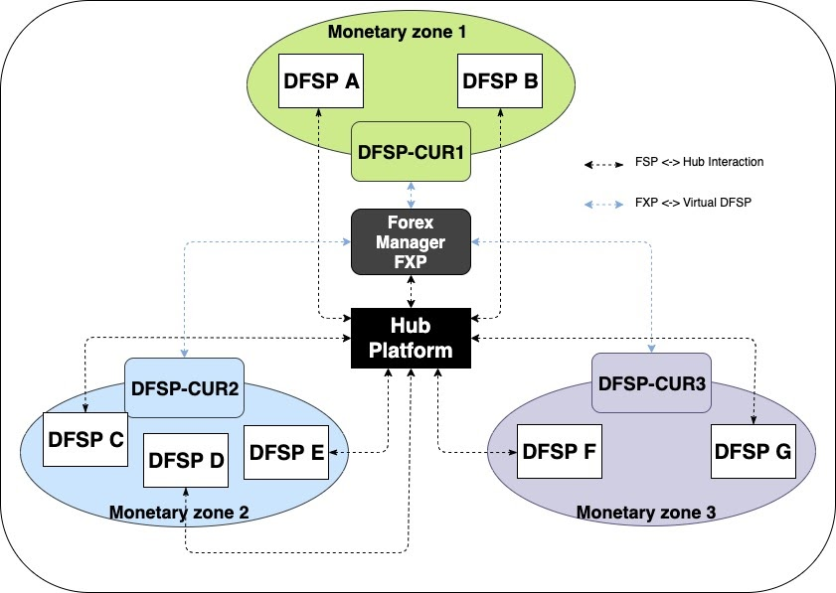
How does FXP work

Slide 5
Problems we encountered
Exchange Rates
Quotes & Transfers
Settlement

Slide 6
Problems we encountered
Exchange Rates

Slide 7


Exchange Rates - Dealing with Real Money in a transfer
EURUSD Rate = 1.1090
This means for 1 EUR I will receive 1.1090 USD
Sarah wants to send 57.50 EUR to Sanjay who has an account in USD
The amount to be received will be 57.50 * 1.1090 = 63.7675 USD.
How to round? 63.76 or 63.77
Whichever way means there will be a discrepancy when we come to settlement of multiple transfers

Slide 8


Exchange Rates – A solution for rounding on a quote
The solution - ensure that the least amount extra is quoted !
That changes dependng on the type of Quote
SEND - FX rate on the Request for Quote (rounding down)
RECEIVE - FX rate on the Quote (rounding up)

Slide 9



Exchange Rates – Rounding Solution in practice
Exchange Rate = 10.415
SEND 1 EUR
1 x 10.415 is rounded down to 10.41
General Rounding would apply as 10.42
OK - Sort of make sense
RECEIVE 10.41 MAD
10.41 / 10.415 is rounded up to 1.00
General Rounding would also apply as 1.00
but there are some edge cases 10.32 /10.415 is rounded up to 1

Slide 10


Exchange Rates – We risk confusing the customer
How to Store the Currency Pair
Major Currency First? EURAUD
Alphabetic First ? AUDEUR
.
Exchange rates for a Currency pair are stored for one direction based on the Base Currency - this is the industry standard

Slide 11
Exchange Rates – Another chance to confuse your customer
Currency Pair is EURMAD. In this case EUR is the Base Rate. But they are given as Bid and Offers
10.412 Spot Bid rate | 10.435 Spot Offer Rate.
This is the rate that the FX Provider sells the Base Rate. | This is the rate that the FX Provider buys the base rate. i.e. 1 EUR will cost 10.435 MAD
For 1 EUR sent 10.412 MAD will be received | For 1 MAD sent 0.09583 EUR will be received ( 1 / Offer Rate)

Slide 12
Exchange Rates – Another chance to confuse your customer ctd
Exchange Rate = 10.412 (Bid)
SEND 100 EUR
OK - Sort of make sense
Receive 1041.20 MAD
Exchange Rate = 10.435 (Offer)
VERY DIFFICULT FOR END USER TO UNDERSTAND RATE USED IF MONEY MOVING MAD -> EUR
Receive 95.83 EUR (1000 / Offer Rate)
SEND 1000 MAD

Slide 13
Exchange Rates – A solution for both
The solution - convert the rate into unidirectional pairs !
Exchange rate stored twice for each Currency Pair
Once with base currency as EUR and once with MAD as the base currency.
They will just have buy rates to show the customer
EURMAD Rate = Bid rate ( 10.412)
MADEUR Rate = 1/Offer Rate ( 1/10.435) = 0.9583133
ROUNDING ISSUE FOR CALCULATION MAY CAUSE CONFUSION i.e. showing 0.9583 for MADEUR

Slide 14
Problems we encountered
Quotes and Transfers

Slide 15
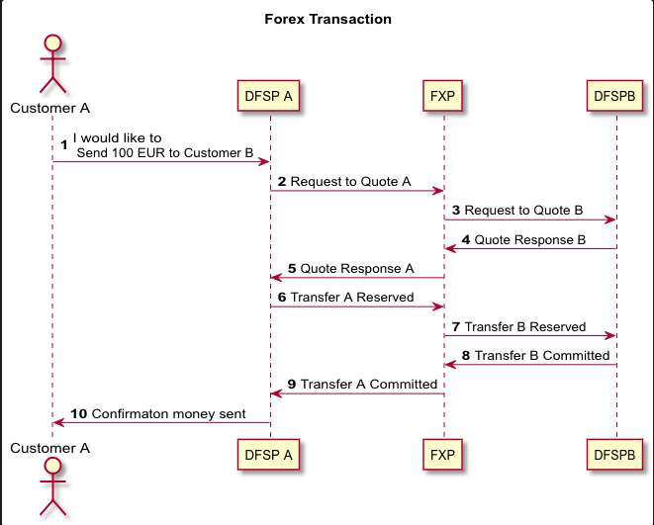
Transaction – 2 Separate quotes and transfers
[A] and [B] Represent 2 separate quotes & transaction– One for each Currency
Need to be linked together :
parenttransferID stored in Extension list

Slide 16

Transaction – Edge Cases
Timeouts and other Edge Cases
Telescopic timeouts - Need to ensure that the timeout for the second leg is less than the timeout for the first leg
If there are failures on Leg B , we need to replicate the failure for Leg A as either both transactions should complete or neither
Where to Commit?

Slide 17
Problems we encountered
Settlement

Slide 18
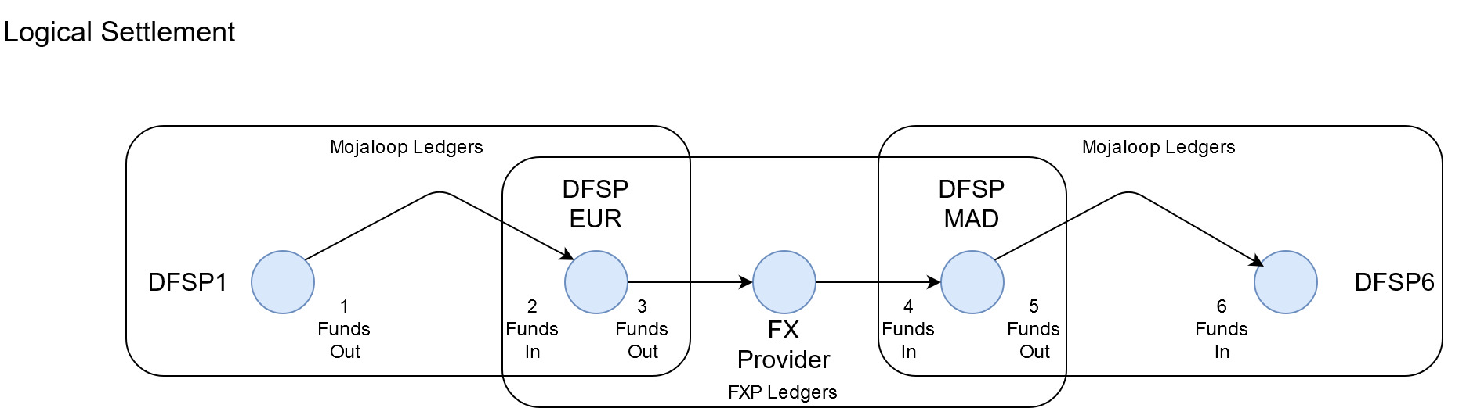
Settlement – Logical Vs Physical
Currently Logical and Physical settlement are tightly coupled within Mojaloop, however they are two separate processes. Logical settlement is recording money movements within the ledgers.

Slide 19
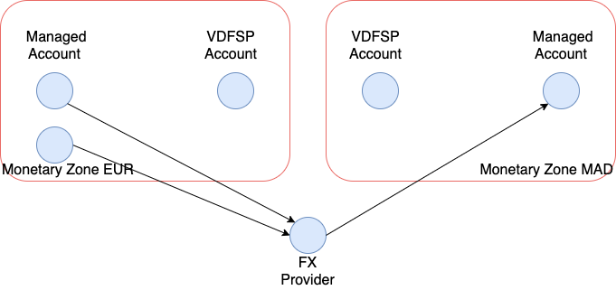
Settlement – Logical Vs Physical
Physical settlement is the actual money movement in the real world

Slide 20
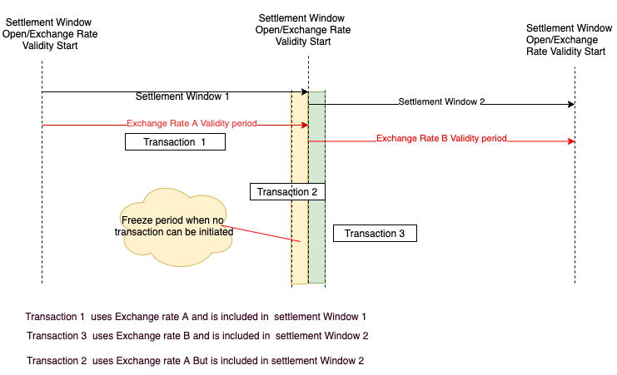
Settlement – Because logical & Physical are linked in Mojaloop
Mojaloop tightly couples settlement window closures with physical settlement. As a consequence Window Closure has to match Exchange Rate Expiry if the window is used to define the amounts traded and settled
Forex trade takes place for window 1
Transaction 2 is included in settlement Window 2.
Window 2 will be settled at a different exchange Rate

Slide 21
Settlement - How to resolve this short term
Short Term
Stop transactions being performed in a ‘freeze period’ so that we can be sure that the transaction starts and finishes in the same settlement window.
This freeze period should equal the validity length of Quote A.
However as the validity period of a quote may be several minutes this isn’t practical as no transactions can be performed for that time.

Slide 22
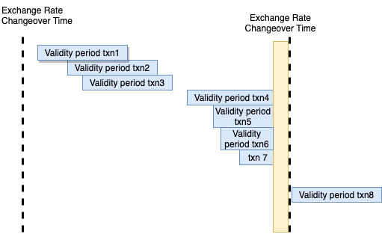
Settlement - How to resolve this medium term
We introduce the Diminishing Quote expiry Time. As you get closer to the end of the exchange rate Validity period the Quote expiry length decreases to match

Slide 23
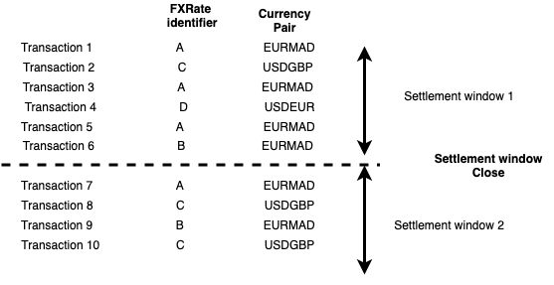
Settlement - How to resolve this long term
Decouple the settlement window from exchange rate validity period
Logically settle by settlement window
Physically settle by exchange rate
The Settlement Window Closure is purely for accounting within the ledgers.
The Physical Settlement will be for a FXRate Identifier/Currency Pair and can happen at any point

Slide 24
Settlement – Reconciliation & Rounding
We need to reconcile that the transactions the FXP is settling matches those at the Hub
To do this we need to be able to maintain ledgers at both the Hub and FXP

Slide 25

Settlement – Revenge of the Rounding
The Sum of the parts does not equal the whole!
So the sum of individual transactions will not equal the amount that is requested as part of the Forex trade
Exchange Rate Used = 10.4130
Amount Type | EUR Amount | MAD Amount
SEND | 53.00 | 551.88
SEND | 172.00 | 1791.03
SEND | 1430.00 | 14890.59
Total | 1655.00 | 17233.50
Total to be converted = 1655 EUR
Using the exchange rate this will give : 1655 * 10.4130 = 17233.51
The expected amount is different to what will be received by 1 cent

Slide 26

Thank you
Jo Sowden Jo.Sowden@modusbox.com
Rob Reeve Rob.Reeve@modusbox.com

